Slide 1


Banking APP
With JDBC

Slide 2

CONTENT
01
JAVA
02
JDBC Connections
03
SCOPE OF PROJECT
04
PROJECT CONFIGURATIONS
05
DEPENDENCIES
06
FUNCTIONAL REQUIREMENTS
07
OPERATING ENVIRONMENT USED
08
HIERARCHY OF PROJECT ARTIFACTS

Slide 3
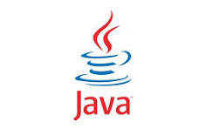

Java
Java is the high level object oriented programming language that is designed to be platform independent.
The term WORA, write once and run everywhere is often associated with this language.
It means whenever we compile a Java code, we get the byte code (.class file), and that can be executed (without compiling it again) on different platforms provided they support Java.
Key features and aspects of java:
Platform independent.
Object Oriented
Syntax
Automatic memory management
Security
Popular Frameworks
.

Slide 4
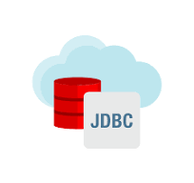
JDBC
JDBC is an API(Application Programming Interface)used in JAVA Programming language to interact with the databases.
Classes and interfaces of JDBC allow the application to send requests made by users to the specified database.
Working of JDBC:
JAVA application that needs to communicate with the database has to be programmed using JDBC API.
JDBC Driver supporting data sources such as Oracle SQL server has to be added in java application for JDBC support which can be dynamically done at runtime.
This JDBC driver intelligently communicates the respective data source.

Slide 5

SCOPE OF PROJECT
1.Transaction Processing : Primary purpose of this project is to process banking transactions stored in ‘BankTrans’ table.
Application calculates new balance based on transaction types(‘D ‘and ‘W’) and determines validity.
2.Database Interactions :This project involves connecting to an oracle database using JDBC.
It uses both ‘Statement’ and ‘PreparedStatement’ for querying and updating database.
3.Data Logging : Valid transactions are logged into the ‘ValidTrans’ table.
Invalid transactions are logged into the ‘InvalidTrans’ table.
4. Error Handling : This project handles error for SQL-Exception using ‘try-catch’.
5. Database Scheme : The project assumes the existence of specific database tables (‘BankTrans’ , ’ValidTrans’ , ’InValidTrans’)with predefined schemas.
6. 1Resource Management : The application responsibly closes resources such as ResultSet , Statement and Connection to avoid resource leaks.

Slide 6
Project CONFIGs
Database Connection Configuration
Connection String i.e. JDBC URL
Project Specific Configuration

Slide 7
DEPENDENCIES
  Ojdbc11.jar :It is Config file designed to use with oracle database . Oracle periodically updates their JDBC drivers to include improvements, bug fixes .
  OracleDriver : Oracle Provides JDBC drivers to enable java applications to interact with oracle database.
  Tnasnames.ora :It contains the configuration data which is present in the oracle installation folder.

Slide 8

COMPONENTS
Bank1 Class
Bank1 Class
Other Classes
BASE CLASS

Slide 9
Utility Methods
  Methods provided by preparedStatement:
  setInt();
  setDouble();
  setString();
Methods provided by resultStatement:
getInt();
getDouble();
getString();
LOGIN PAGE 1
LOGIN PAGE 2

Slide 10
Method CHAINING
I have used method chaining for setting parameters in the prepared Statement.
This make code more readable and concise when dealing with multiple method calls on the same object.
I have used setInt(), and getInt() methods for method chaining.

Slide 11
REQUIREMENT ID | REQUIREMENT CATEGORY | REQUIREMENT TYPE | PRIORITY | HIERARCHY | REF
R001 | FUNCTIONAL | STATED | HIGH
REQUIREMENT DESCRIPTION | ESTABLISHING DATABASE CONNECTION
SCOPE | Loading the database driver & establish communication with database. Create & execute the statement. Retrieve the data returned by the statement. Close the connection
REQUIREMENT METHODOLOGICAL DETAILS | For loading database driver we have used forName() method of class For establishing connection we have used getConnection() method which is static method of DriverManager class. For creating statement we have used CreateStatement() method of connection interface. For executing statement we’ve used executeQuery() method of statement interface. Retrieved the data returned by the statement. Closed the connection using Con.Close();

Slide 12


OPERATING ENVIRONMENT
01
02
03
JAVA
SQL
JDBC

Slide 13
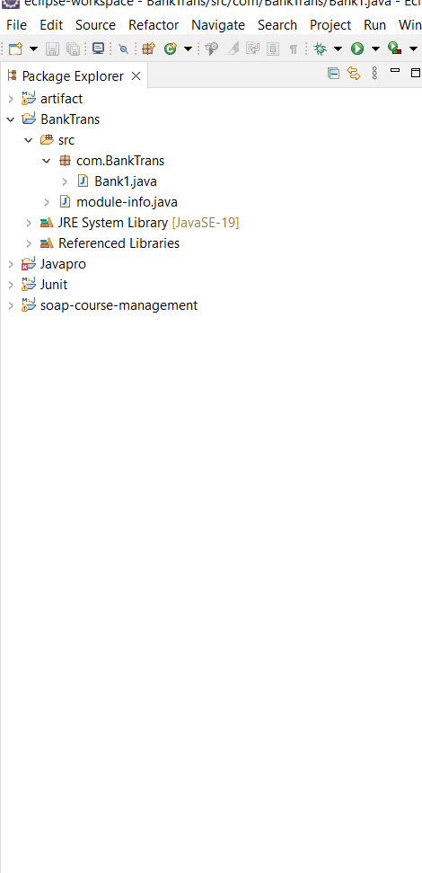
Hierarchy of Project Artifacts

Slide 14

THANK YOU
By :Vaishnavi Biradar

